Slide 1

Data Science 100 Principles & Techniques of Data Science
?
Slides by:
Deborah Nolan deborah_nolan@berkeley.edu
Spring 2018 updates
Fernando Pérez fernando.perez@berkeley.edu

Slide 2
Announcements for Today
Midterm is scheduled for March 8 during class
We will try using Google forms today, but may need to resort to clickers/cell phone
Slides and notes from lecture available online at http://ds100.org/sp18
HW 1 will be released next Tuesday (Jan 23).

Slide 3
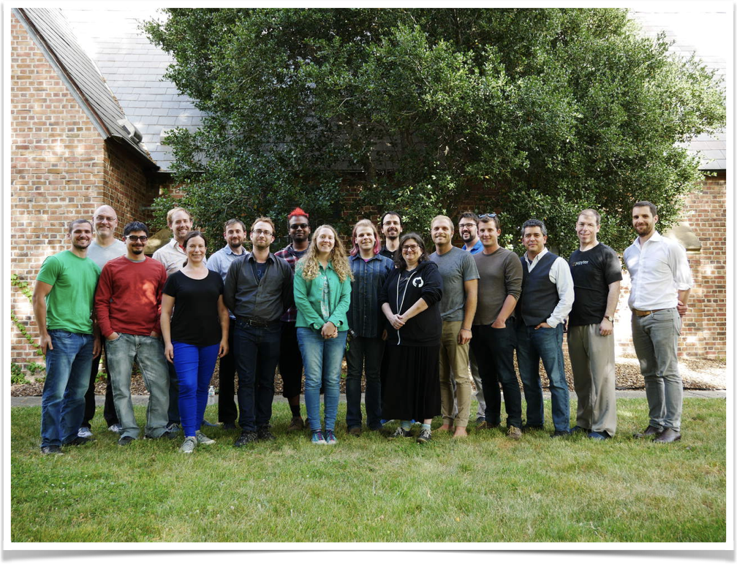

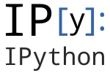
A quick bit about me
New faculty in statistics department (Fall 2017)
Physics, applied math background
Open source tools for science, reproducible research, interactive data science
Fernando Pérez
419 Evans
OH: Tues 2-4pm
Over 1,400 contributors!

Slide 4
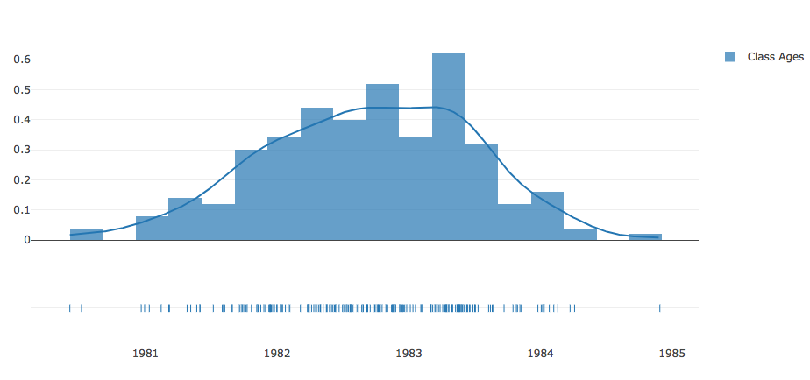
Let’s finish name/age model from Tues.

Slide 5
Three themes in DS 100
Problem formulation
Data Provenance
Implications of scale
Each class will address one or more of these themes
Notes:
Problem formulation: framing a question to be answered, so that we can then ask what data, model and computational strategies will be needed to answer the question.
Data provenance: our focus today.
As we saw in our attempts at predicting the age of the class from names, data provenance matters.
Scale: the “big data” question, which has computational and statistical implications. Scale brings challenges (storage, performance) and opportunities (modeling impossible to do with small data, extraction of weak signals). But big data doesn’t magically absolve us from thinking carefully about statistical questions. In many ways it makes it harder, as it can mislead us into complacently thinking that scale will steamroll the problems away.

Slide 6
Data Provenance
We take a narrow approach to this topic

Slide 7
How were these data generated?
The mechanisms by which the data arose impacts whether we can answer the question of interest
Can we generalize beyond what we observe in our data?
Notes:
We’ll work through some examples that illustrate these points today.

Slide 8
How were these data generated?
Do they form a census – information on all subjects?
Are they a subset or sample?
Was a chance mechanism used to select the sample?
Or, is this a self-selected, convenience, or judgment sample?
Or, an administrative database?
Were the data generated from
a collection in nature
an industrial process
a social science study
Notes:
Judgment sample: someone decided who should be on the sample. With what criteria?
Convenience sample: stand on Sproul Plaza and survey passer—by.
Administrative data: campus student db, Kaiser patients, IRS data…
We’ll mostly focus on social/human data. But industrial and scientific datasets can be extremely interesting and rich.

Slide 9
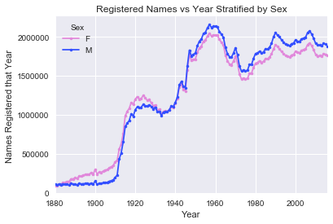
Baby Names Data
Do they form a census?
Can we use our findings to make generalizations about the students in this class?
SSN system created 1937
Notes:
The Baby Names dataset: names corresponding to all SSNs by birth year.
Remember: for privacy reasons, only names with at least 5 babies born in the same year are included.

Slide 10
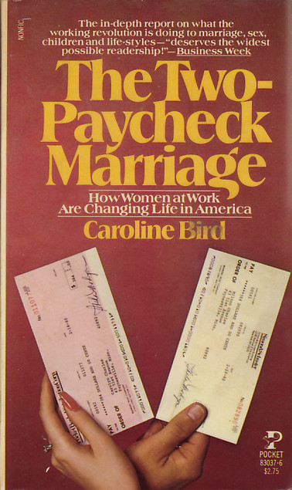
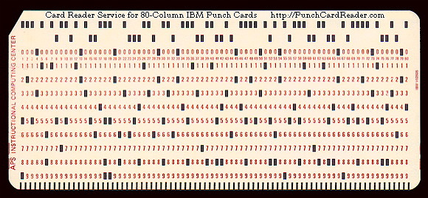
Statistical Science – A first encounter (D. Nolan)
Data collected from questionnaire published in Women’s Day magazine
Thousands of women responded to questions about their lifestyle
Notes:
Prof. Deb Nolan was an intern for Caroline Bird, and author.
C. Bird was famous for her book The case against college (1975), that argued parents would be better off putting money in the bank since their kids birth rather than sending them to college. Very controversial.
This book (1982): women were only then entering the workforce in very large numbers.
She put out a questionnaire in a popular women’s magazine and got thousands of response. Prof. Nolan was tasked with analyzing these data.
Question: how were these data generated?
Census? Sample? If sample, what kind? (self-selected, convenience, judgment…)?

Slide 11
Statistical Science – A first encounter
Do they form a census – information on all subjects?
Were there enough responses to overcome any issues with a nonprobability sample?
NOPE
NOPE
Notes:
Were there enough responses to overcome the problems with the collection of the data?

Slide 12


Computational Science – A first encounter
Market Research Analysts
Applications Programmer
Data Analysis – SAS

Slide 13
Computational Science: powerful tools

Slide 14
The purpose of computing is insight, not numbers.
R. Hamming
Numerical Methods for Scientists and Engineers (1962)

Slide 15
Lessons Learned
Good Data Analysis ≠
Simple Application of a Statistics Recipe
Good Data Analysis ≠
Simple Application of Statistical Software

Slide 16

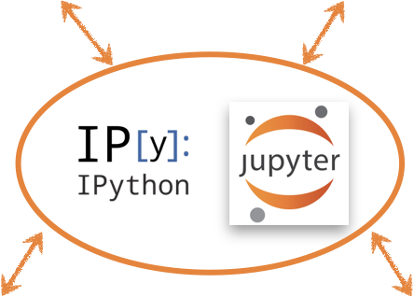



Slide 17

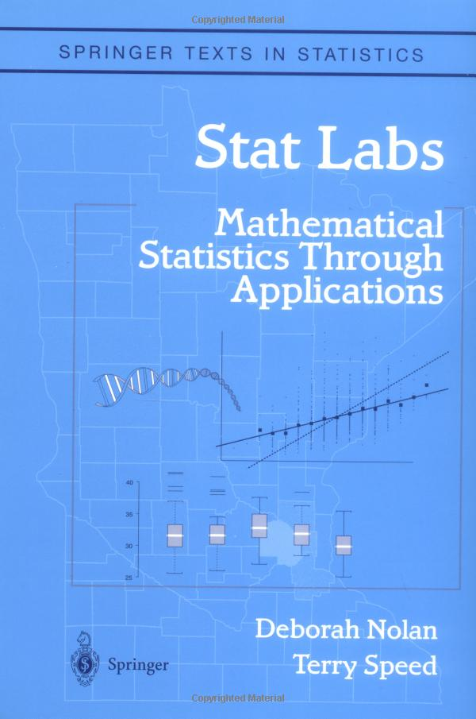
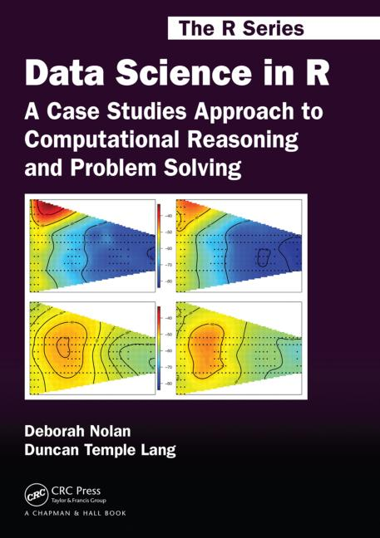
My focus on developing new ways to teach statistics and data science
Teaching Tips
Theoretical Statistics
Case Studies
Data Science
Case Studies

Slide 18
To Answer this question we need an estimate of fertility rates of Harvard mothers
Notes:
Our next example. Prof. Sandel claims to regularly ask his students how many are first born, and that ~75% are. He claims this is evidence for the first born effect.
What is the ‘first born effect’?

Slide 19
DETOUR: 1. What is a simple random sample? 2. Why is it so desirable? 3. Can we make up for not having a SRS with big data?
Notes:
This detour will help us think about who are the Harvard mothers whose fertility properties we need to study.

Slide 20
What is a Simple Random Sample?
Notes:
Somebody?
Wikipedia: a simple random sample is a subset of individuals (a sample) chosen from a larger set (a population). Each individual is chosen randomly and entirely by chance, such that each individual has the same probability of being chosen at any stage during the sampling process

Slide 21
What is a simple random sample?
A sample where every person is equally likely to be chosen?
Does this uniquely define the SRS?

Slide 22

What is a simple random sample?
A sample where every person is equally likely to be chosen?
Does this uniquely define the SRS?

Slide 23
The Simple Random Sample
Suppose we have a population with N subjects
We want to sample n of them
The SRS is a random sample where every possible unique subset of n subjects has the same chance of appearing in the sample
This means each person is equally likely to be in the sample
Notes:
For review purposes – just discussed in live notes.

Slide 24
Why is the SRS so Useful?

Slide 25
The Advantages of a SRS
Representative: The sample tends to look like the population
Statistics based on the sample tend to be close to statistics based on the population
We can provide typical deviations of sample statistics from population values.
AND MORE…

Slide 26
Fertility of mothers aged 40-44

Slide 27
Fertility of mothers aged 40-44
8.7 million mothers aged 40-44 in the US (CPS)
The have 1, 2, 3, or 4+ children (we treat 4+ as 4)
Take a Simple Random Sample of 400 (simulate)
 | Number of Children
 | 1 | 2 | 3 | 4+
Percent mothers | 21% | 43% | 23% | 13%
Notes:
Using data from 1994.

Slide 28
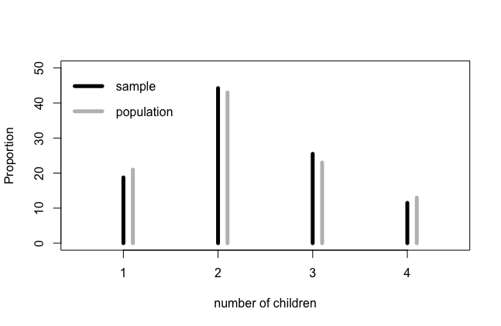
One sample of 400 from 8.7m
Sample AVG = 2.29
Population AVG = 2.28
Notes:
A very small sample (relatively speaking) does a very good job of estimating properties of the population.

Slide 29
Repeat
A sample AVG from a SRS will fall close to the true population mean

Slide 30
Can we make up for no SRS with Big Data?

Slide 31
Harvard Professor Meng asked a room full of statisticians at an international conference something like this:
Suppose we want to estimate a proportion of people in the US that have a particular characteristic. We can either take a SRS of 100 people, or examine an administrative dataset where those who have the characteristic are slightly ore likely to be included in the dataset. How large does the AD need to be to provide a more accurate estimate than the SRS?
5% (16m) B. 20% (64m)
C. 50% (160m) D. 90% (206m)
Survey: http://bit.ly/d100-sp18-afd
More: Meng 2013, A trio of inference problems that could win you a Nobel Prize in statistics…
Notes:
No fancy calculation, respond with your intuition.

Slide 32
Please also answer the following questions:
Are you your birth mother’s first born?
How many children does your birth mother have? (including you)

Slide 33
Three possibilities
SRS of 400 mothers
SRS of 400 of the children
An administrative dataset with 80,000 mothers, where those with more children are slightly more likely to be included in the database
Which of these three approaches better?

Slide 34
SRS of 400 children
Compare the chance a child from a 2 children family is chosen to the chance an only child is selected
What does this imply about the estimate for the average number of children?
Can we fix this problem?
This is size-biased sampling
Why?
We can fix the problem if we know how many siblings each child has
Notes:
Families with more children will be oversampled.
We won’t get into the tools for correcting this bias in this course.

Slide 35
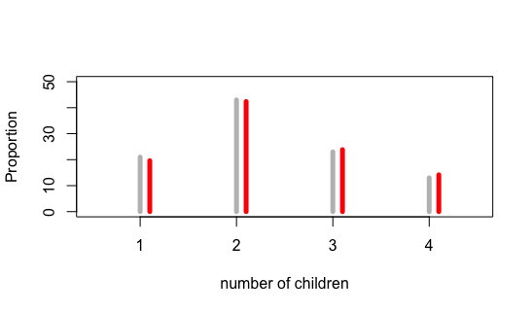
Administrative Data of 80000 mothers
Compare the proportions in the true population to our administrative dataset
This can’t possibly make a difference, right?

Slide 36
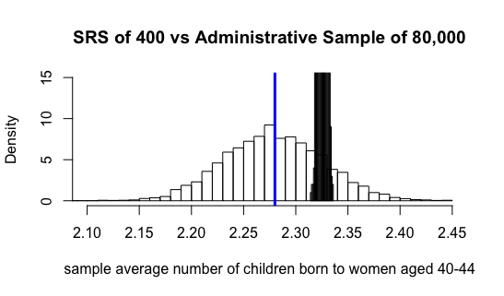
Administrative Data of 80,000 mothers
Compare the accuracy based on 1000 simulations of Administrative Correlated Data

Slide 37
Are first-borns more likely to attend Harvard?
And What about Berkeley?

Slide 38
First-borns predominate at Harvard
Professor Sandel found 75% of the students in his class are first born
We know from our study of mothers aged 40-44
The proportion of first born children in this group of children: 100/(21 + 86 + 69 + 52) = 1/2.3 = 0.44 or 44%
 | Number of Children
 | 1 | 2 | 3 | 4+
Percent mothers | 21% | 43% | 23% | 13%
Notes:
At first glance, it seems like there’s a very strong first-born effect at Harvard.
Or, is there? …

Slide 39
First-borns predominate at Harvard
BUT that’s the wrong comparison
What about Data Provenance?
How large are Harvard families?
Do we have any reason to believe that mothers of Harvard students might not have the same fertility rate as all US mothers aged 40-44?
Notes:
Are families of Harvard kids smaller than the US population average?

Slide 40
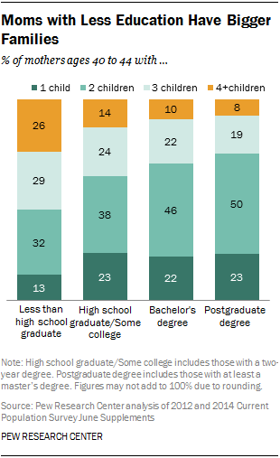
According to Pew Research Center
How might this impact the proportion of first born at Harvard?
http://www.pewsocialtrends.org/2015/05/07/family-size-among-mothers/

Slide 41
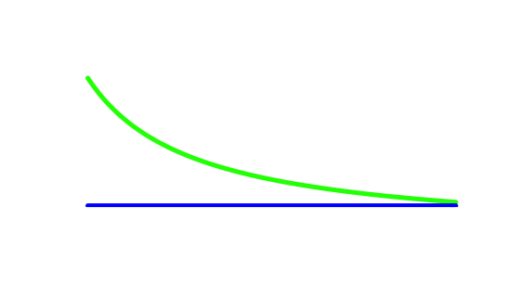
Can Big Data compensate for no SRS?
Size matters, but only after we have quality
Big does not guarantee better
With a slight correlation between the presence of the characteristic and the appearance in the dataset, the accuracy of a SRS of 100 outperforms a AD of 90%
I Got More Data, My Model Is More Refined…, Meng & Xie (2014)
Econometrics Review
Administrative Data
Accuracy of SRS of 100
Sample Size (16m to 288 m)

Slide 42
Are first-borns more likely to attend Harvard?

Slide 43
Children of mothers with at least one child at Harvard

Slide 44
Children of mothers with at least one child at Harvard
First
Born

Slide 45
Children of mothers with at least one child at Harvard
Harvard
Student
First born Harvard
Student
First
Born
Want

Slide 46
Find the chance first born is at Harvard
We want to find the chance you are a Harvard student (H) given you are first born (F) and
Compare it to the chance you are a Harvard student given you are not first born
Notes:
Remember, this is the definition of Conditional Probability.

Slide 47
Find the chance first born is at Harvard
So the ratio becomes:
Recall
Which implies Bayes Rule
Professor observed ¾ for P(F|H).
But we need the fertility rate for Harvard moms

Slide 48
Find the chance first born is at Harvard
So the ratio becomes:
If we plug in the US value for 1994 we get: r = 3.9
If we plug in the US highest educated value from Pew we get: r = 3.2
We need the fertility rate for Harvard moms…
Notes:
P(F), your chance of being first-born, is 1/fertility aka 1/(avg family size), as we saw above.
Bummer situation:
We can’t really assert that this probability is 75%
We can look at the ratio, but our answer is highly dependent on a very good estimate of the fertility rate.

Slide 49
Can Big Data compensate for no SRS?
Big Data is not enough
With a slight correlation between the presence of the characteristic and the appearance in the dataset, the accuracy of a SRS of 100 outperforms a AD of 90%
I Got More Data, My Model Is More Refined…, Meng & Xie (2014)
Econometrics Review
Administrative Data
SRS of 100

Slide 50
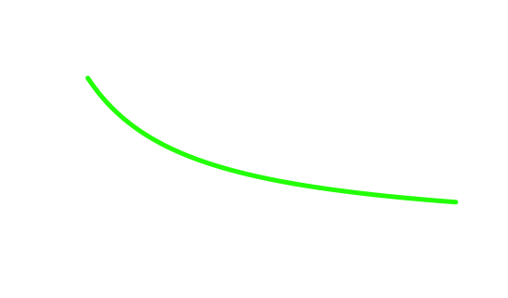
Can Big Data compensate for no SRS?
Administrative Data
Accuracy of SRS of 100
Accuracy
(combination of variance and bias)
Sample Size (16m to 288 m)

Slide 51
Find chance 1st born is in Data 100 @ Cal
Note we made a rough attempt to correct for size bias in our sampling

